Slide 1
AstroSwipe
Here is where your presentation begins

Slide 2
CONTENTS OF THIS TEMPLATE
Here’s what you’ll find in this Slidesgo template:
A slide structure based on a multi-purpose presentation, which you can easily adapt to your needs. For more info on how to edit the template, please visit Slidesgo School or read our FAQs.
An assortment of illustrations that are suitable for use in the presentation can be found in the alternative resources slide.
A thanks slide, which you must keep so that proper credits for our design are given.
A resources slide, where you’ll find links to all the elements used in the template.
Instructions for use.
Final slides with:
The fonts and colors used in the template.
A selection of illustrations. You can also customize and animate them as you wish with the online editor. Visit Storyset by Freepik to find more.
More infographic resources, whose size and color can be edited.
Sets of customizable icons of the following themes: general, business, avatar, creative process, education, help & support, medical, nature, performing arts, SEO & marketing, and teamwork.
You can delete this slide when you’re done editing the presentation.

Slide 3
01
CONTINUT
02
03
Ideea
You could describe the topic of the section here
Conceptul
You could describe the topic of the section here
Tehnologii
You could describe the topic of the section here

Slide 4

WHOA!
This could be the part of the presentation where you can introduce yourself, write your email…

Slide 5
—ASTROSWIPE DEV TEAM
“Your constellation is my attraction.”

Slide 6
01
Ideea
You can enter a subtitle here in case you need it

Slide 7
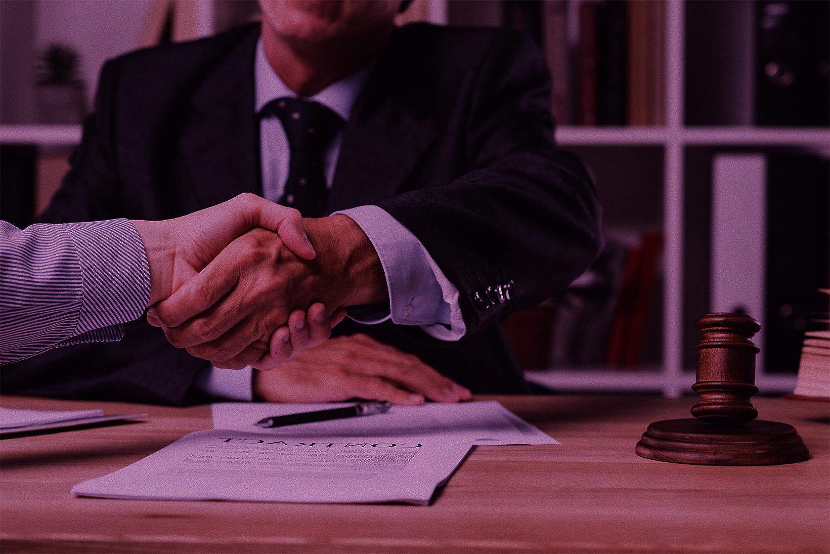
Ideea proiectului
Proiectul a pornit in urma dorintei de a integra mai multe tehnologii utilizate si cerute. Astfel incat toti am invatat si folosit aceste tehnologii pentru a ajunge la un produs final care poate fi vandut.
Baza de date online
Frontend conectat cu backend
Virtualizare si containerizare pentru portabilitate
Proiectul contine si o parte de deployment care poate fi initializata pe un server cloud pentru a putea fi folosita aplicatia de catre public.

Slide 8
02
Conceptul
You can enter a subtitle here in case you need it

Slide 9
Conceptul proiectului
AstroSwipe este o aplicatie care se muleaza pe publicul tanar. O caracteristica unica a acestei platforme este faptul ca oamenii isi pot gasi o persoana cu care sa comunice bazate pe zodia pe care o doresc ei.
Tinder, o aplicatie contemporana pentru tineri fara functionalitati speciale
The league, o aplicatie care integreaza apeluri video
Clover, o aplicatie care integreaza o functionalitate de creare a grupurilor de convorbiri
Astfel ca, aplicatia vine cu un aspect unic care nu este abordat si integrat de catre alte platforme deja existente pe piata.

Slide 10
03
Tehnologii
You can enter a subtitle here in case you need it

Slide 11
Tehnologiile folosite in cadrul proiectului
PYTHON
ANGULAR
DOCKER
Despite being red, Mars is actually a very cold place
Jupiter is a gas giant and the biggest planet
Mercury is the smallest planet in the Solar System
NEO4J
Despite being red, Mars is actually a very cold place

Slide 12
WHAT ABOUT THESE TWO CONCEPTS?
MERCURY
VENUS
It’s the closest planet to the Sun and the smallest one in the Solar System
Venus has a beautiful name and is the second planet from the Sun

Slide 13
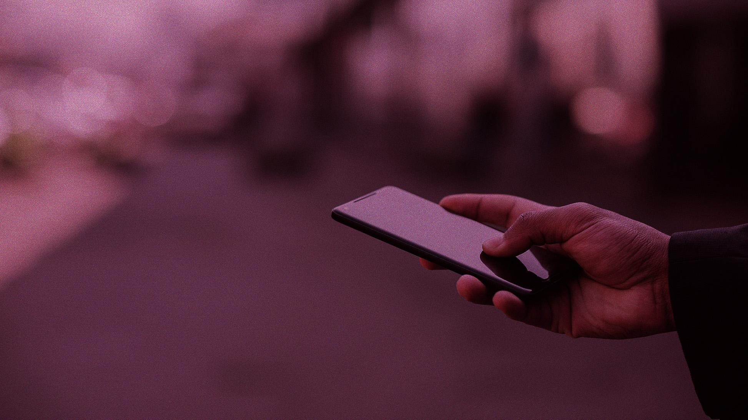
A PICTURE ALWAYS REINFORCES THE CONCEPT
Images reveal large amounts of data

Slide 14
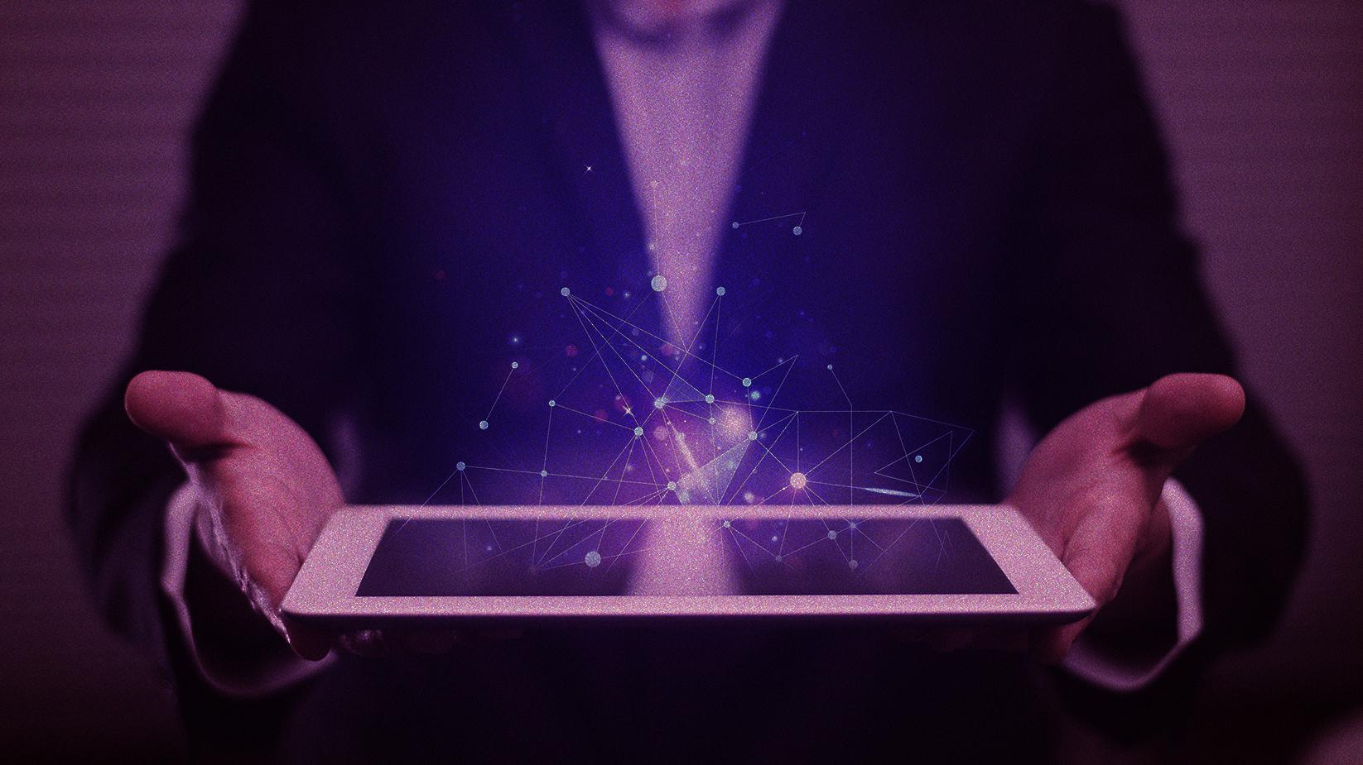
A PICTURE IS WORTH A THOUSAND WORDS

Slide 15
AWESOME WORDS
Because key words are great for catching your audience’s attention

Slide 16
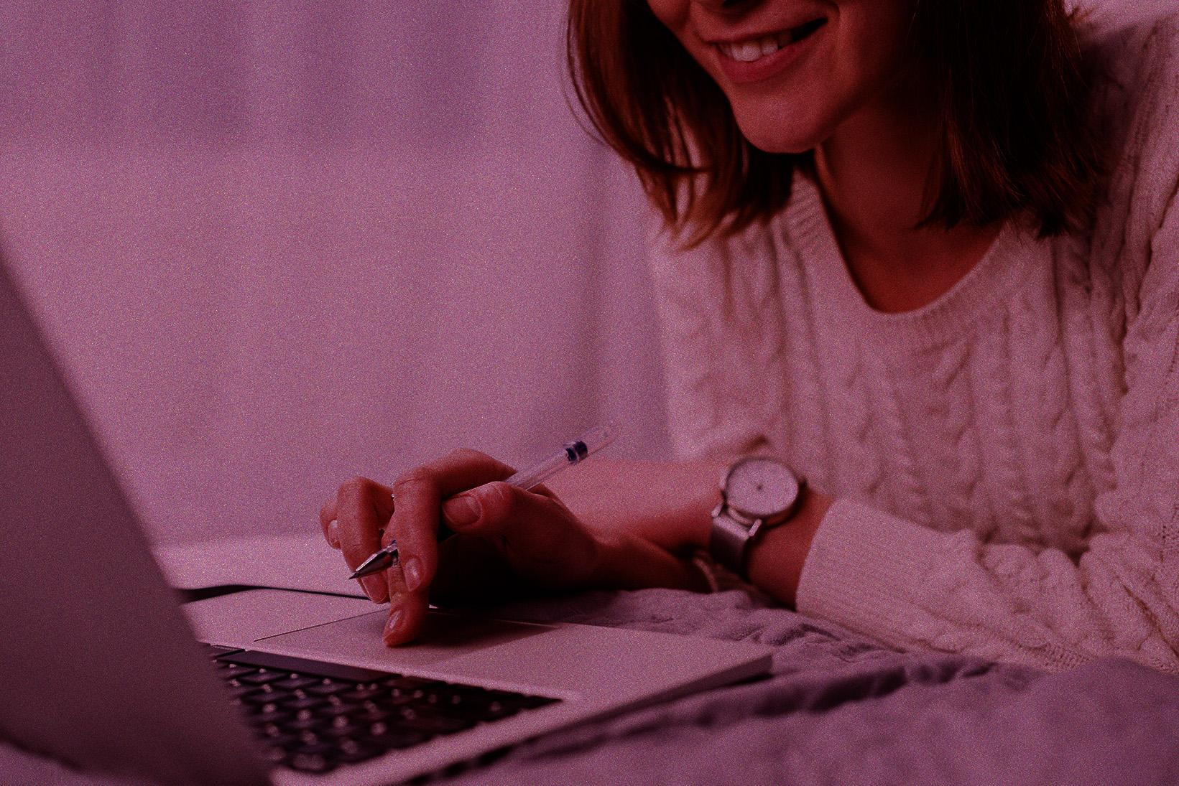
NEED ANOTHER PIC?
01
01
03
02
04
It’s the closest planet from the Sun
Neptune is far away from Earth
Venus is the second planet from the Sun
Despite being red, Mars is a cold place

Slide 17

OUR DATA
60%
Despite being red, is very cold
40%
Neptune is the farthest planet
To modify this graph, click on it, follow the link, change the data and paste the resulting graph here, replacing this one

Slide 18
SOMETIMES, REVIEWING CONCEPTS IS GOOD
MERCURY
VENUS
MARS
Mercury is the closest to the Sun
Venus is the second planet from the Sun
Despite being red, Mars is a cold place
JUPITER
SATURN
NEPTUNE
It’s the biggest planet in the Solar System
Saturn is a gas giant and has several rings
Neptune is the farthest from the Sun

Slide 19
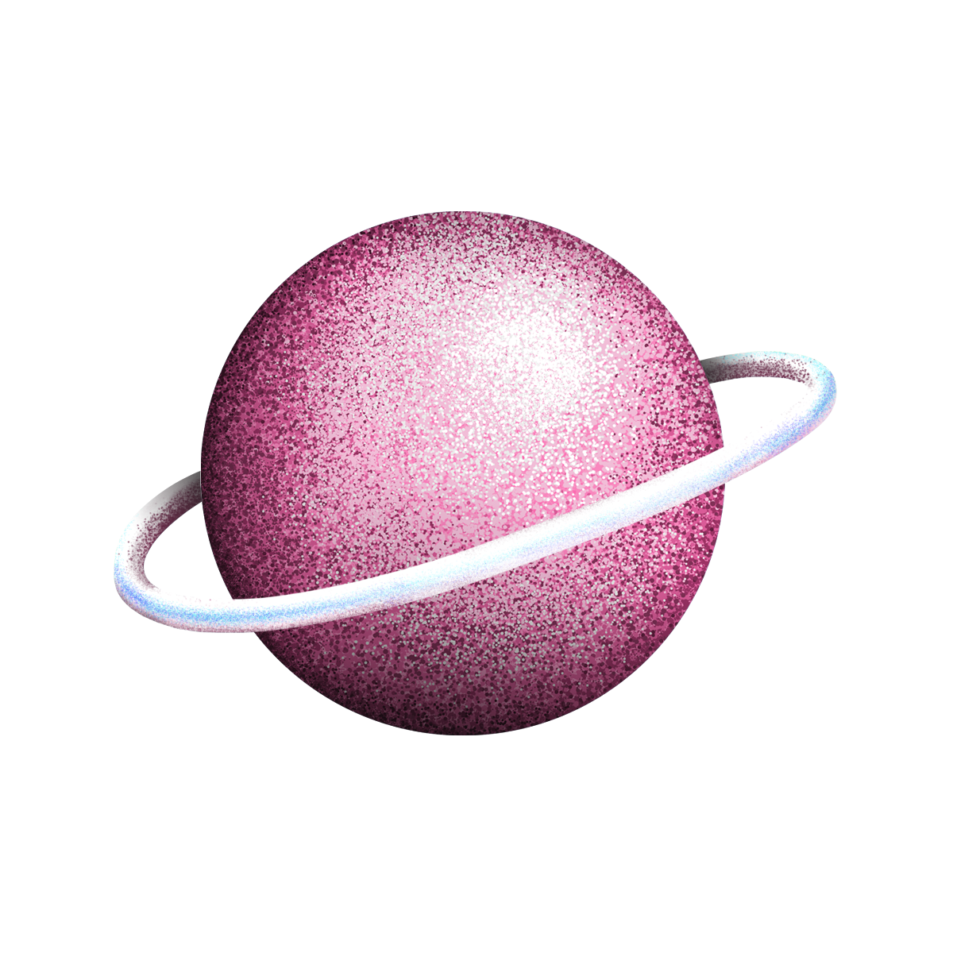
INFOGRAPHICS MAKE YOUR IDEA UNDERSTANDABLE...
Mercury is the smallest planet
A
MERCURY
Venus has a beautiful name
B
VENUS
Jupiter is the biggest planet
C
JUPITER

Slide 20
… AND THE SAME GOES FOR TABLES
 | MASS | DIAMETER | SURFACE
MERCURY | 0.06 | 0.38 | 0.38
MARS | 0.11 | 0.53 | 0.38
SATURN | 95.2 | 9.4 | 1.16

Slide 21
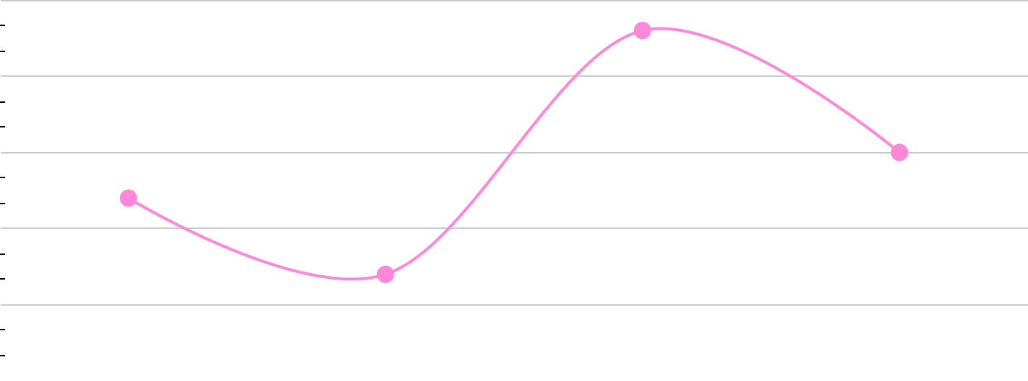
THIS IS ANOTHER GRAPH...
MARS
Despite being red, is very cold
NEPTUNE
To modify this graph, click on it, follow the link, change the data and paste the new graph here, replacing this one
Neptune is the farthest planet

Slide 22
… AND THIS IS A MAP
MARS
Despite being red, is very cold
NEPTUNE
Neptune is the farthest planet

Slide 23
A TIMELINE ALWAYS WORKS WELL
Mars is actually a cold place
Venus is the second planet
2017
2019
2016
2018
2020
Mercury is the smallest planet
It’s the farthest from the Sun
Earth is the planet where we live on

Slide 24
4,467,000
Big numbers catch your audience’s attention

Slide 25
333,000.00
24h 37m 23s
386,000 km
earths is the Sun’s mass
is Jupiter’s rotation period
is the distance between Earth and the Moon

Slide 26
NEED MORE COLUMNS OF TEXT?
01
03
02
04
MERCURY
JUPITER
Mercury is the closest planet to the Sun
It’s the biggest planet in the Solar System
SATURN
NEPTUNE
Saturn is composed of hydrogen and helium
It’s the farthest planet from the Sun

Slide 27
AND PERCENTAGE GRAPHS?
25%
60%
45%
MERCURY
JUPITER
VENUS

Slide 28
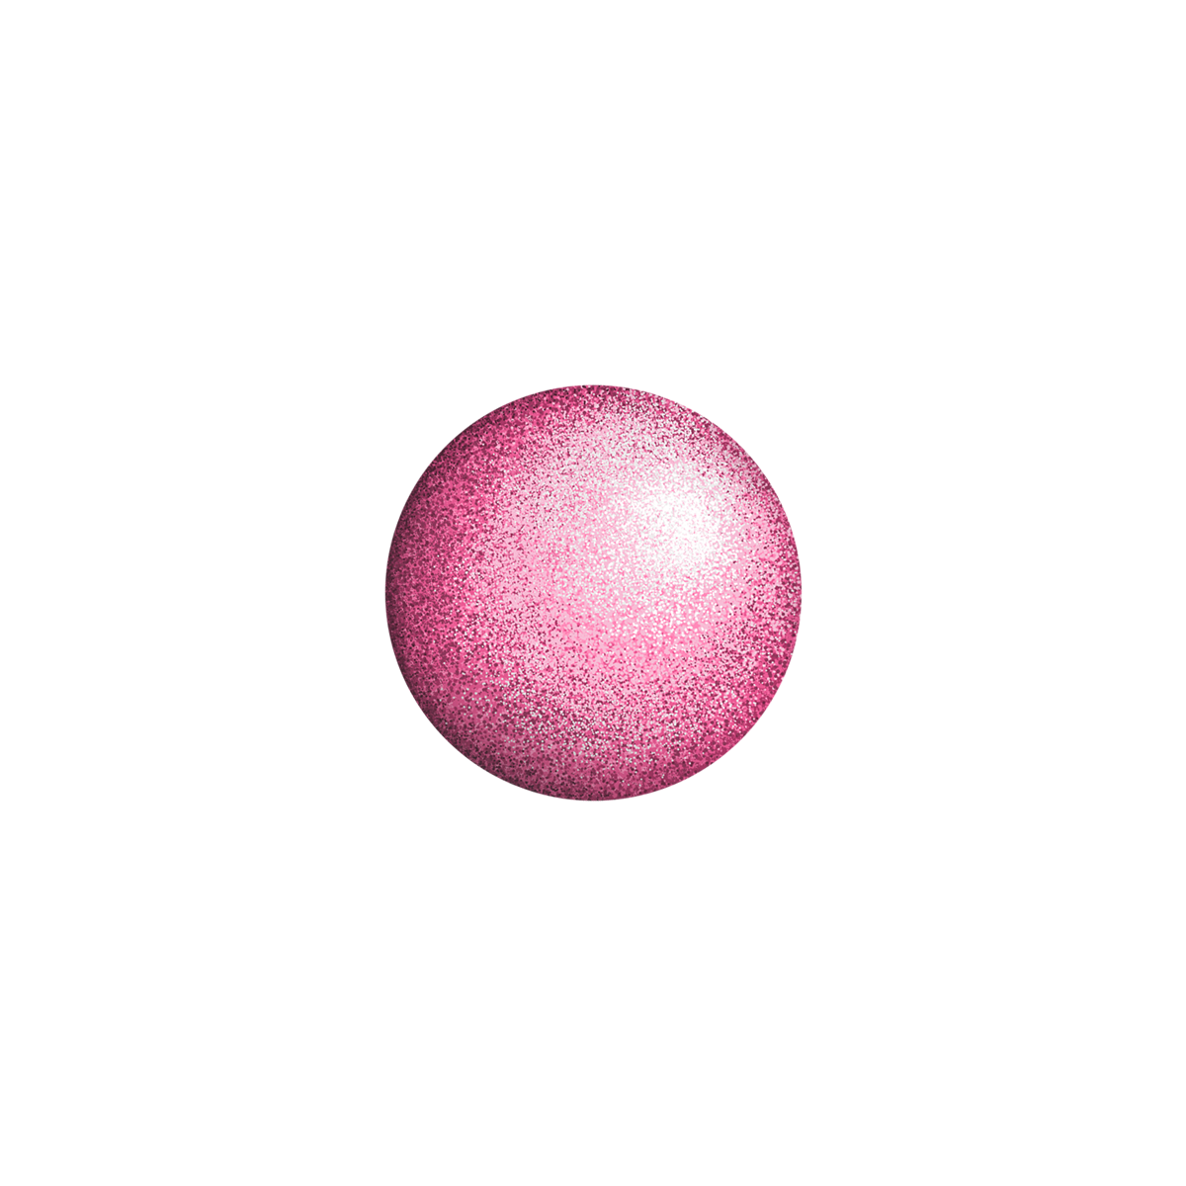
ANOTHER INFOGRAPHIC IS A GOOD IDEA
Mercury is the smallest planet
Earth is where we live on
Saturn has several rings
Venus has a beautiful name
Jupiter is the biggest planet
It’s the farthest from the Sun

Slide 29
LISTS HELP TO MEMORIZE
Mercury is the closest planet and the smallest one in the Solar System
The planet’s name has nothing to do with the liquid metal, since it was named after the Roman messenger god, Mercury
Venus has a beautiful name and is the second planet from the Sun
It’s terribly hot and its atmosphere is extremely poisonous. It’s the second-brightest natural object in the night sky

Slide 30
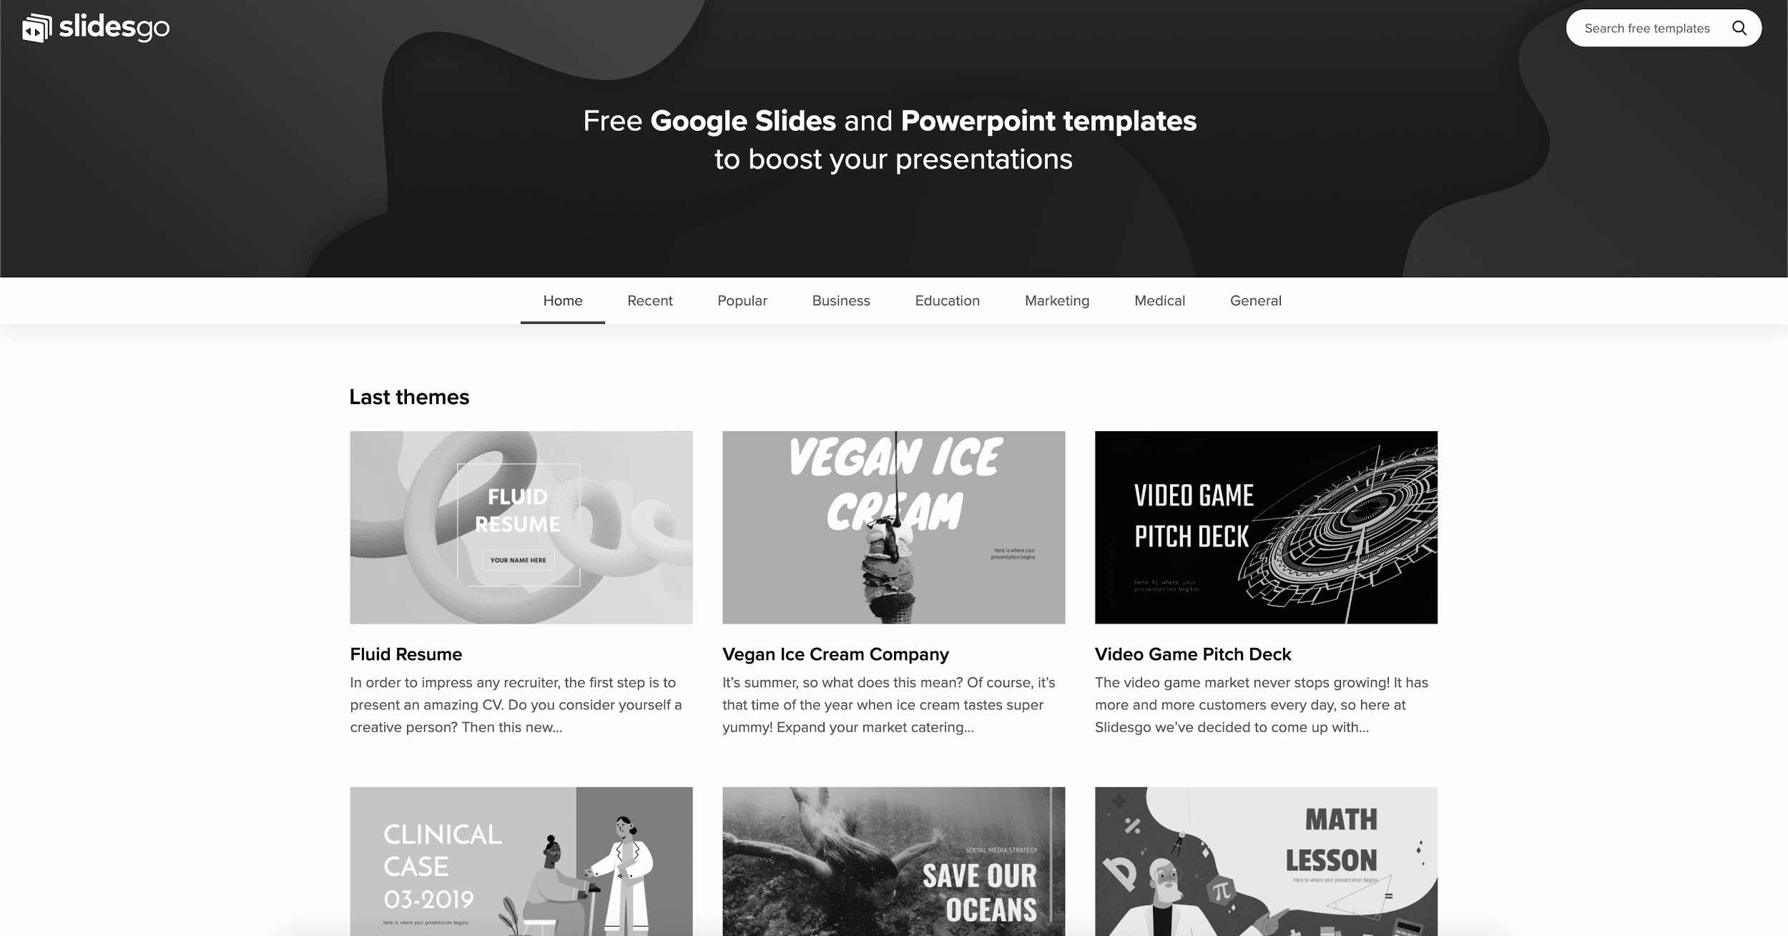
DESKTOP SOFTWARE
You can replace the image on the screen with your own work. Right-click on it and then choose “Replace image” so you can add yours

Slide 31
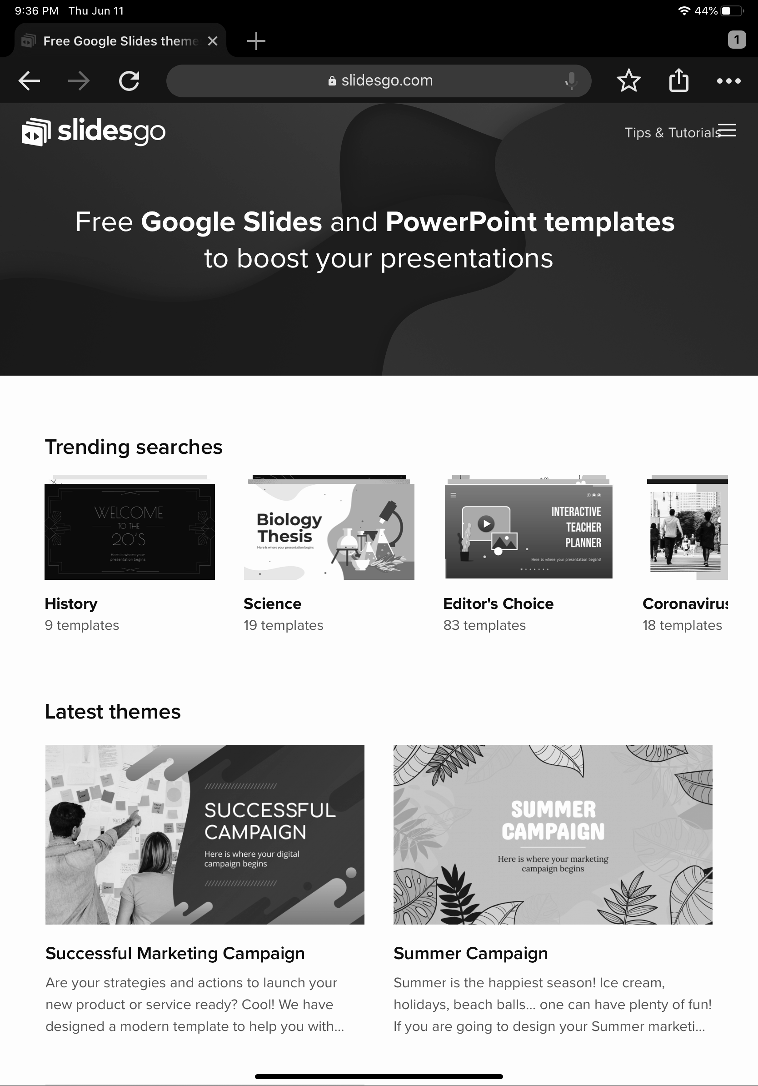
TABLET APP
You can replace the image on the screen with your own work. Right-click on it and then choose “Replace image” so you can add yours

Slide 32
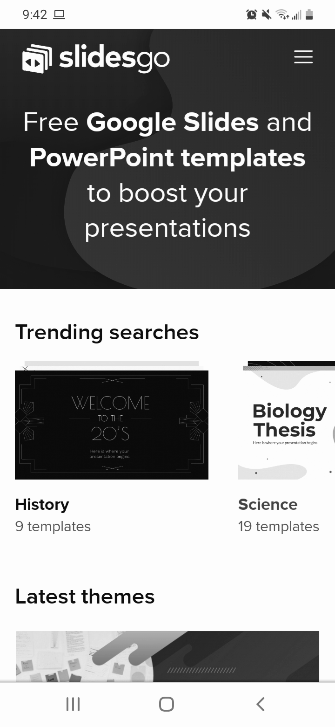
MOBILE WEB
You can replace the image on the screen with your own work. Right-click on it and then choose “Replace image” so you can add yours

Slide 33
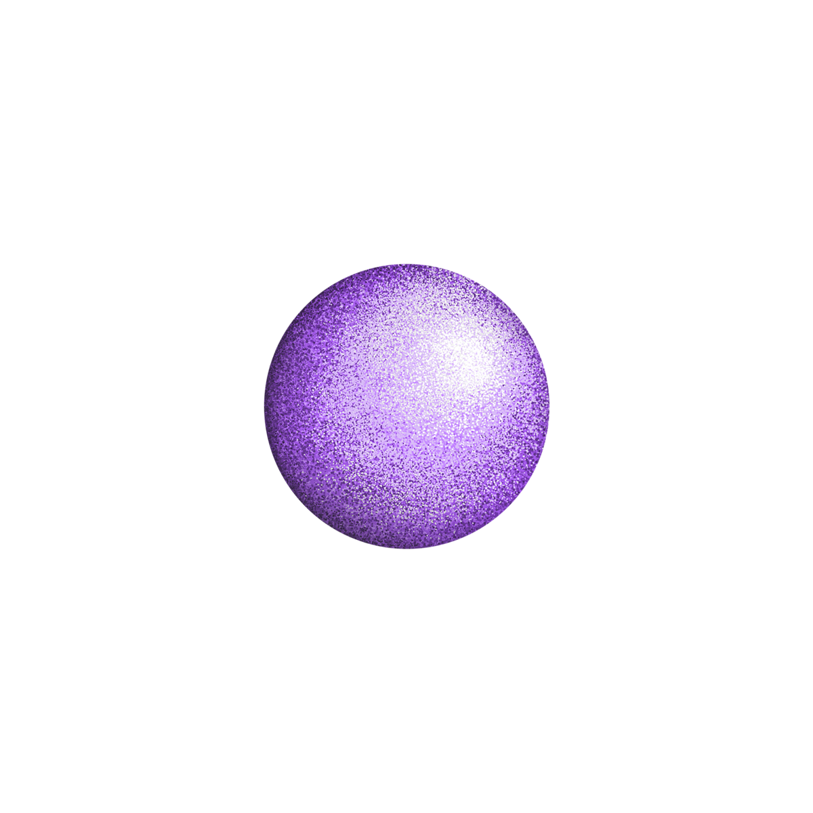
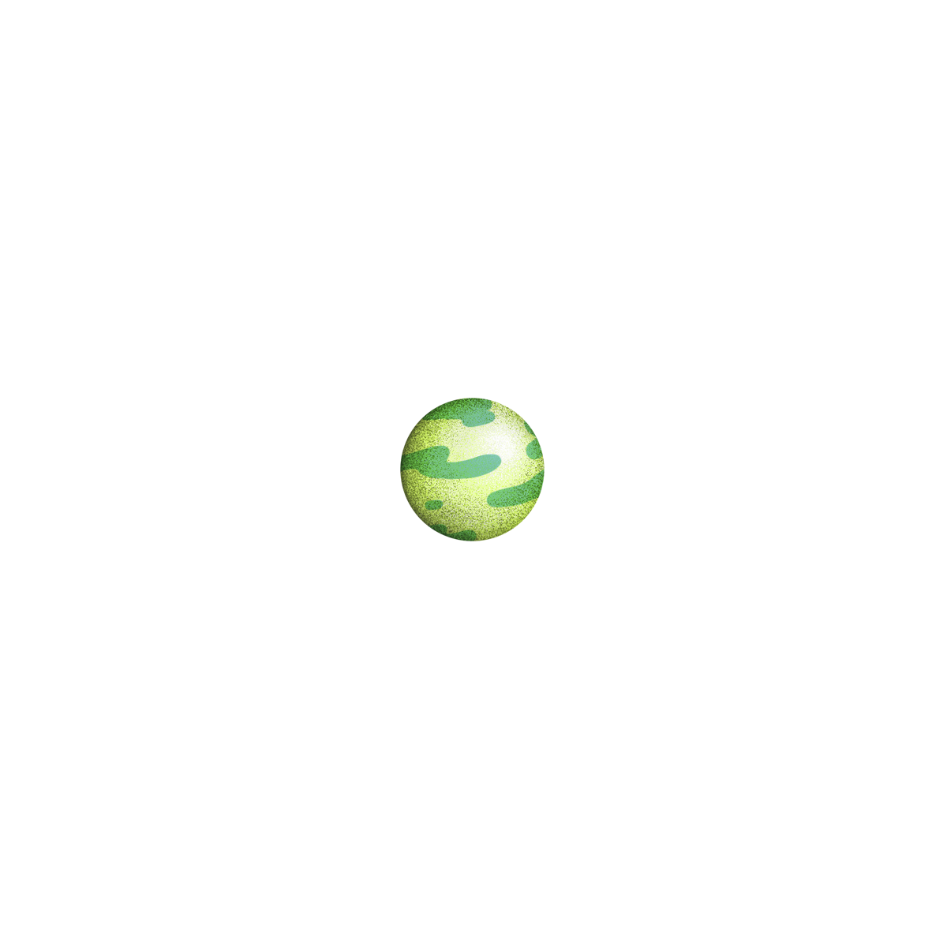
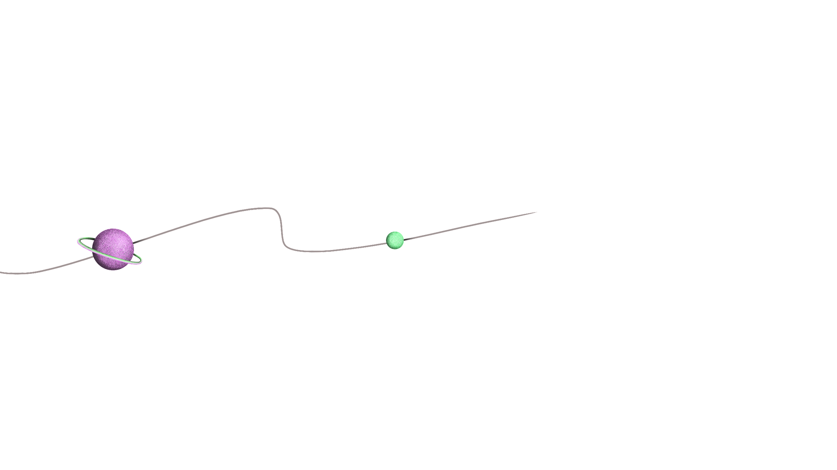
WHAT DO THEY SAY ABOUT PLANETS?
BRADLEY DAWSON
MARIA LEBLANC
MYA CLARKE
“Despite being red, Mars is actually a cold place”
“Venus has a beautiful name, but it’s terribly hot”
“Mercury is the closest planet to the Sun”

Slide 34
CONCLUSIONS
01
03
01
02
VENUS
SATURN
Venus has a beautiful name and is the second planet from the Sun
Saturn, the ringed planet, is composed mostly of hydrogen and helium
MERCURY
Mercury is the closest planet to the Sun and the smallest of them all

Slide 35
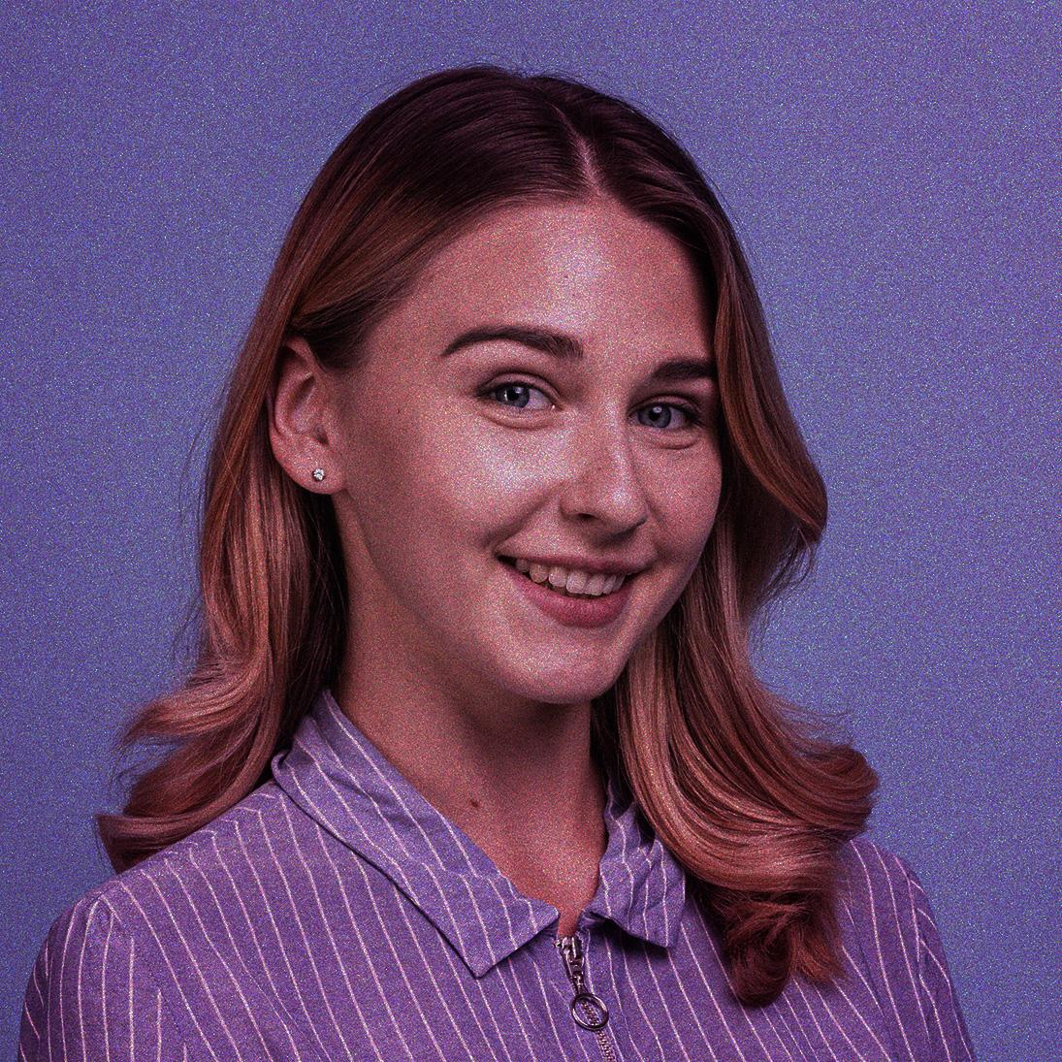
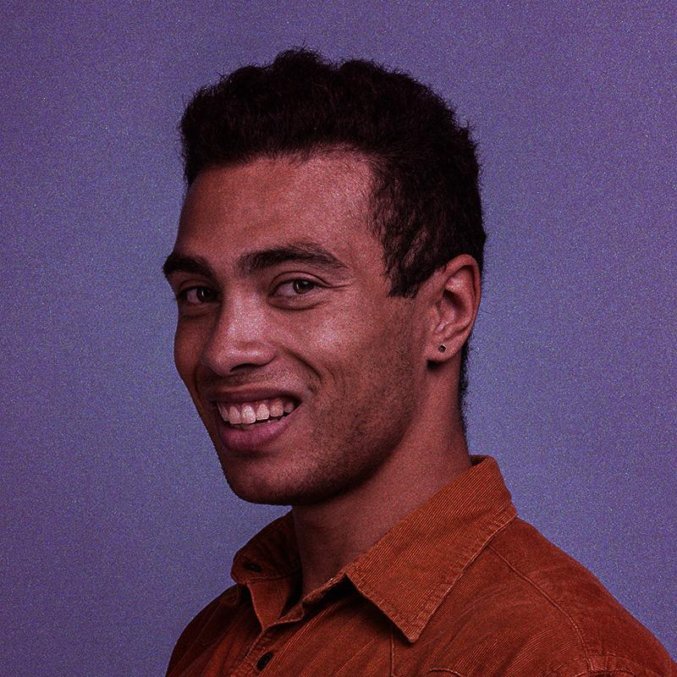
OUR TEAM
HELENA JAMES
JOHN DOE
You can replace the image on the screen with your own
You can replace the image on the screen with your own

Slide 36
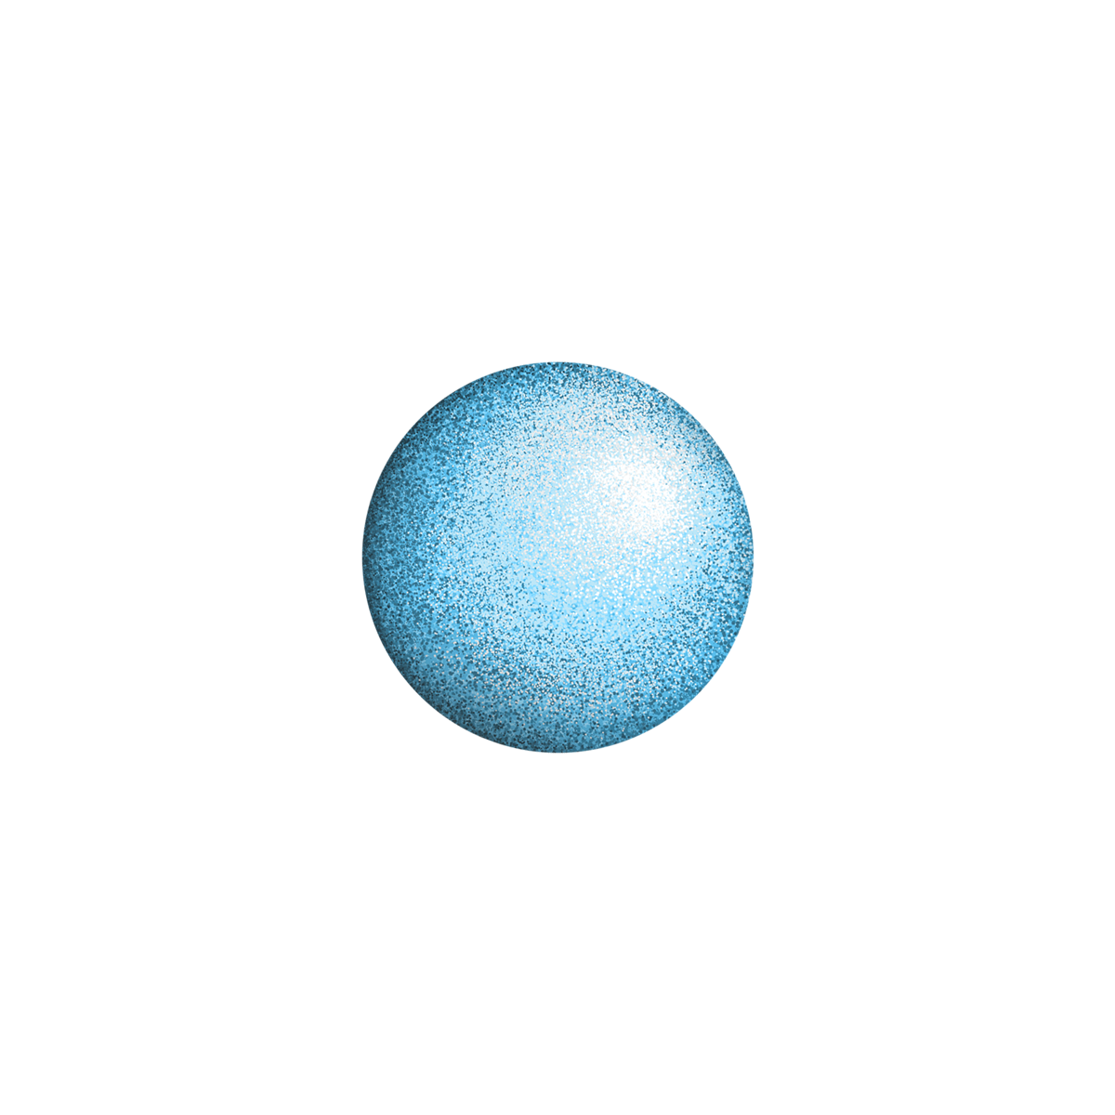

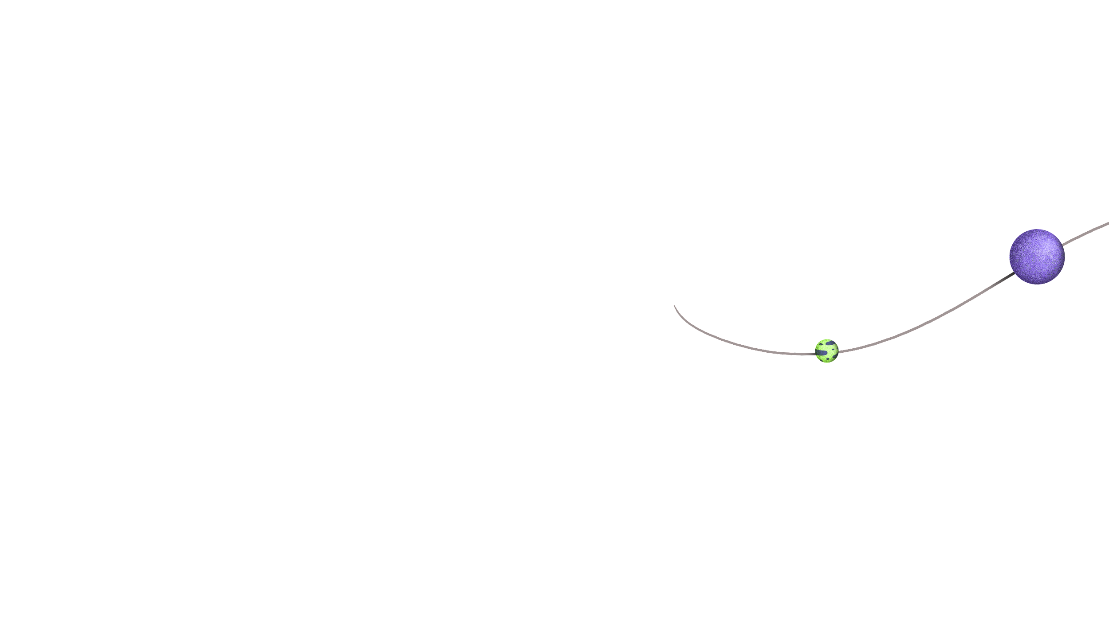
THANKS!
Do you have any questions?
youremail@freepik.com
+91 620 421 838
yourcompany.com
Please keep this slide for attribution

Slide 37
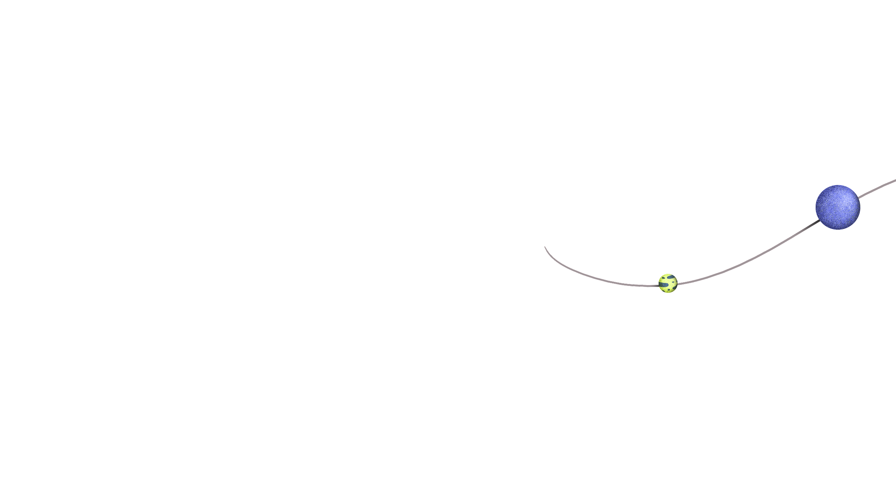
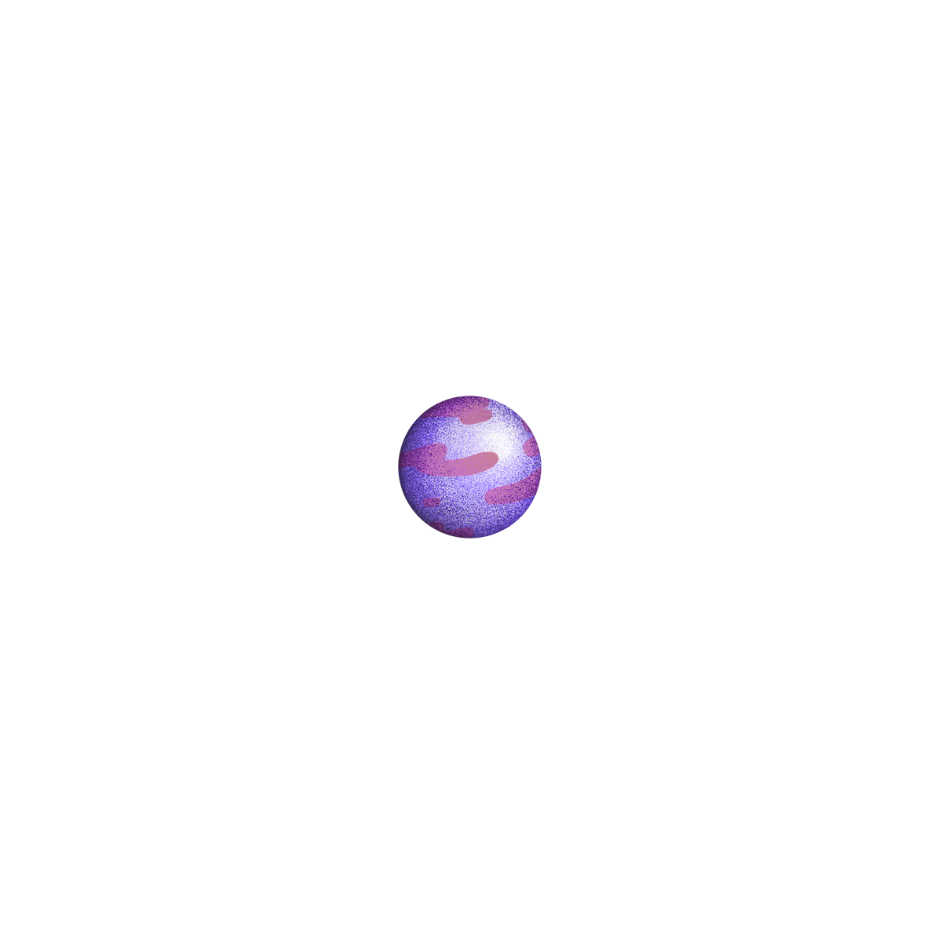
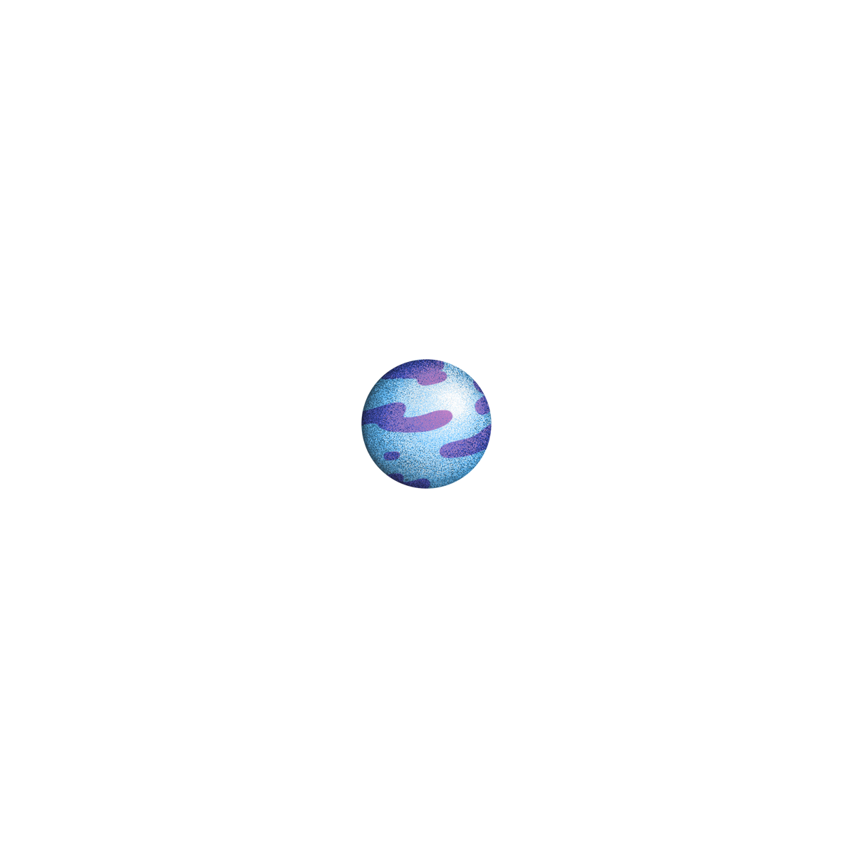
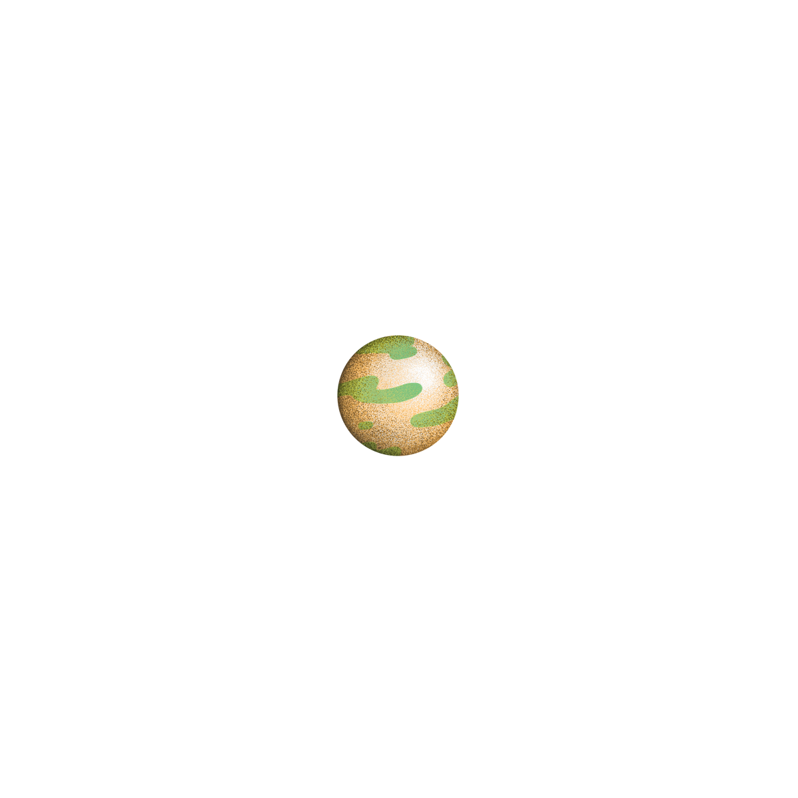
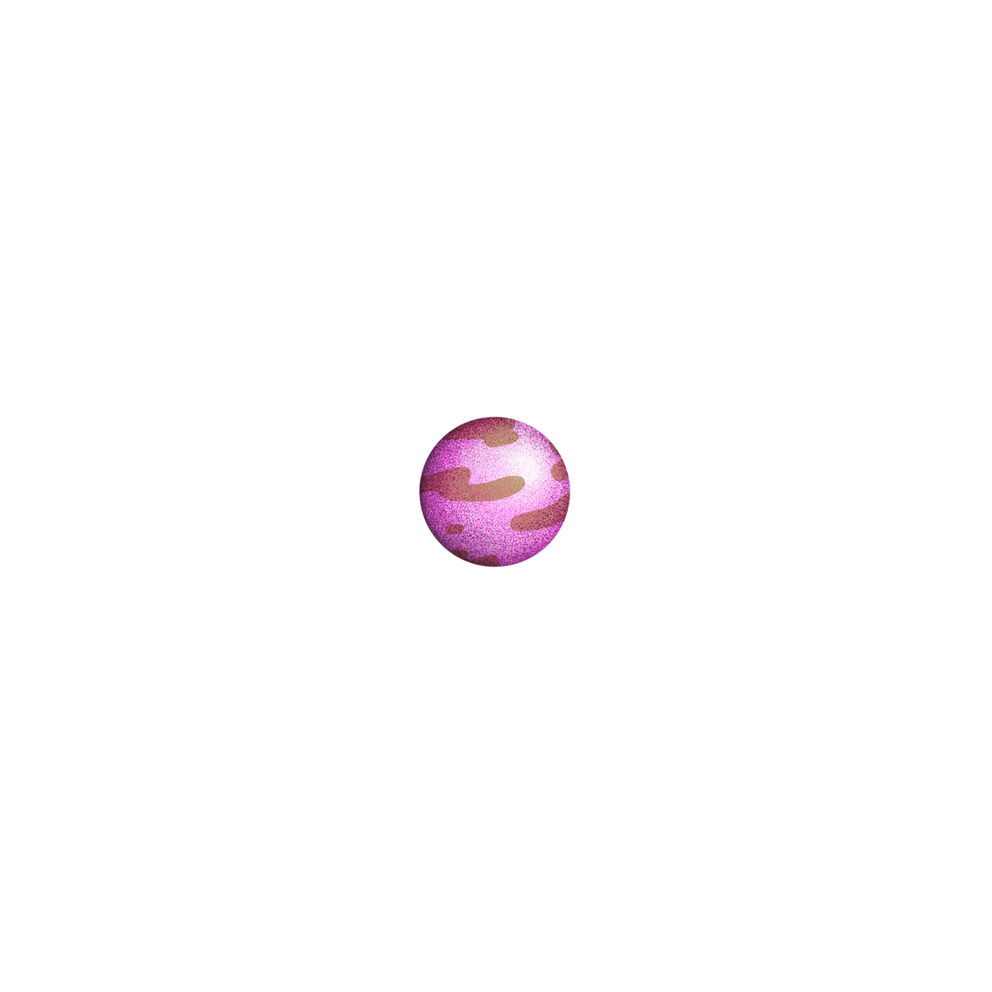
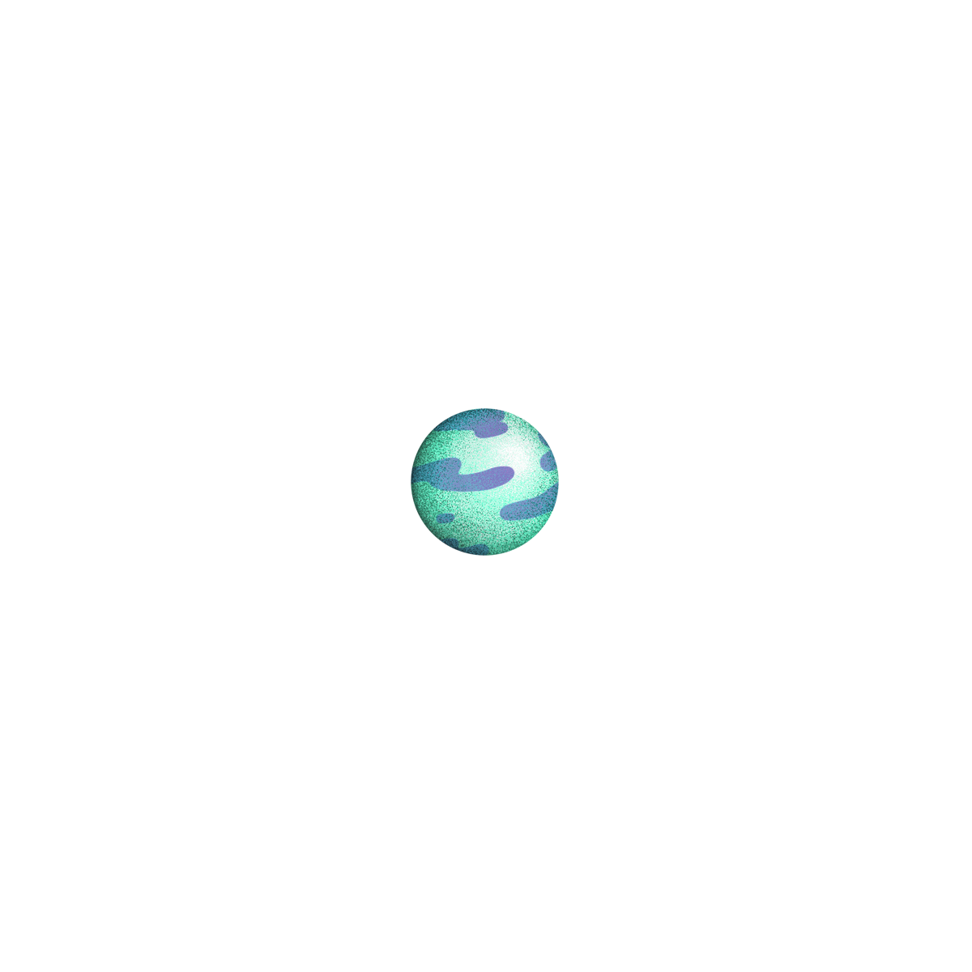

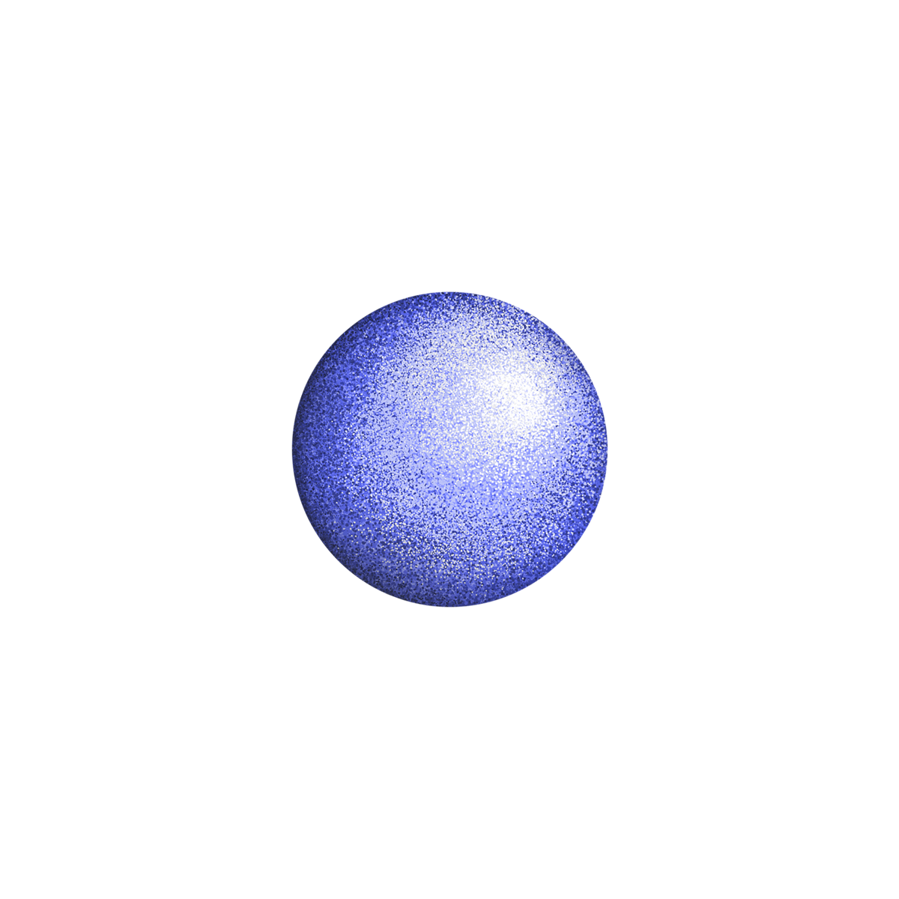
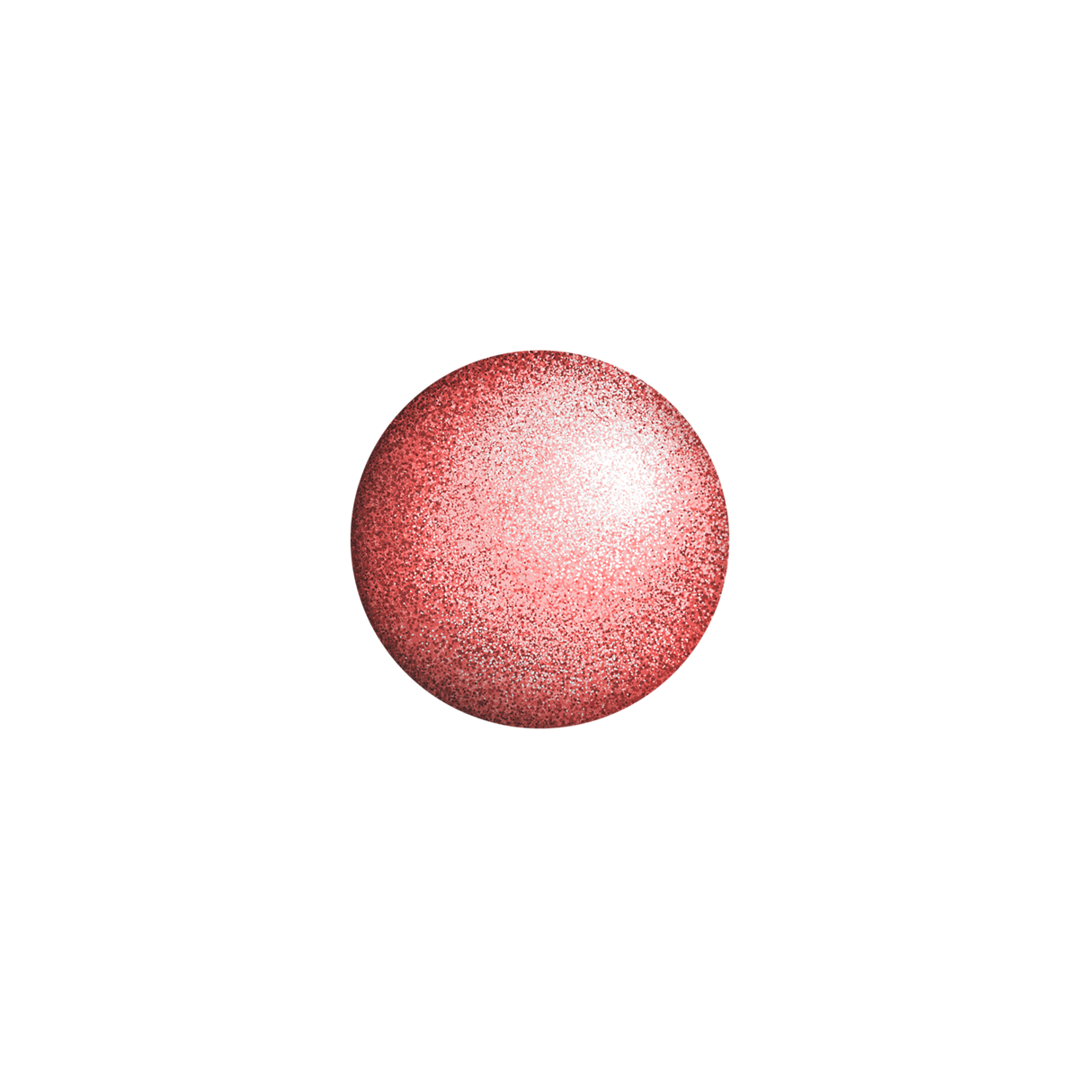
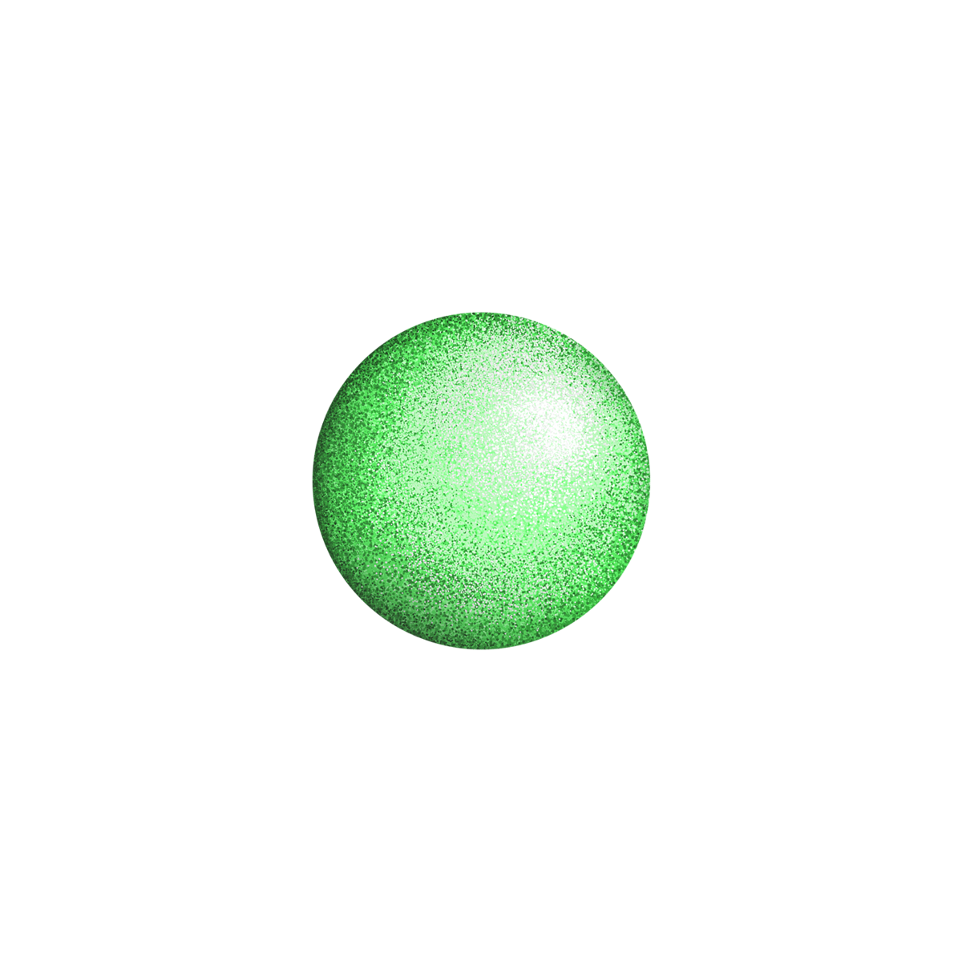
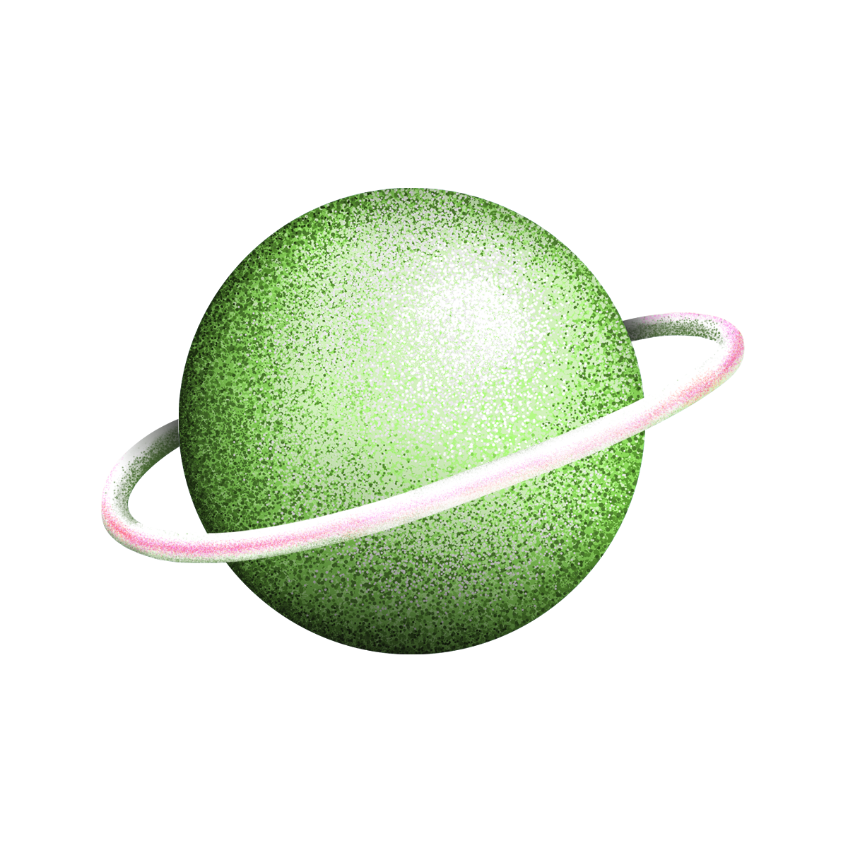
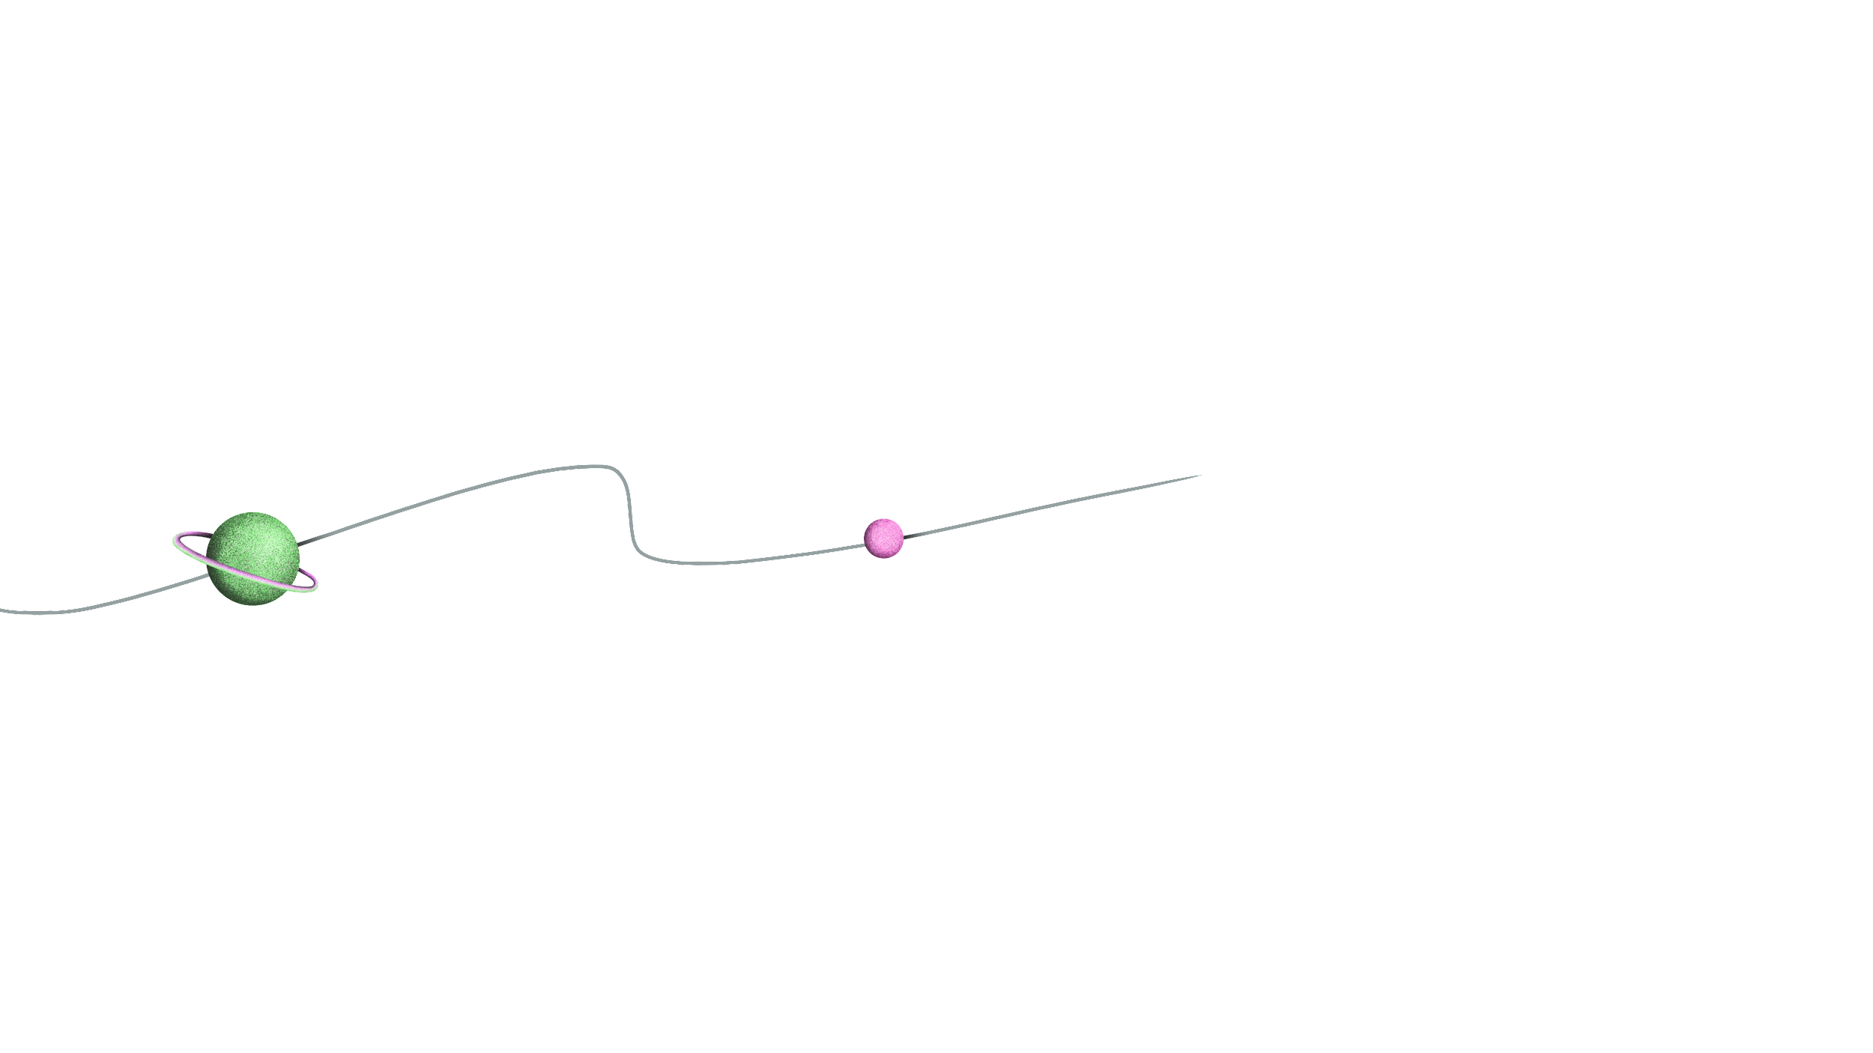
ALTERNATIVE RESOURCES

Slide 38
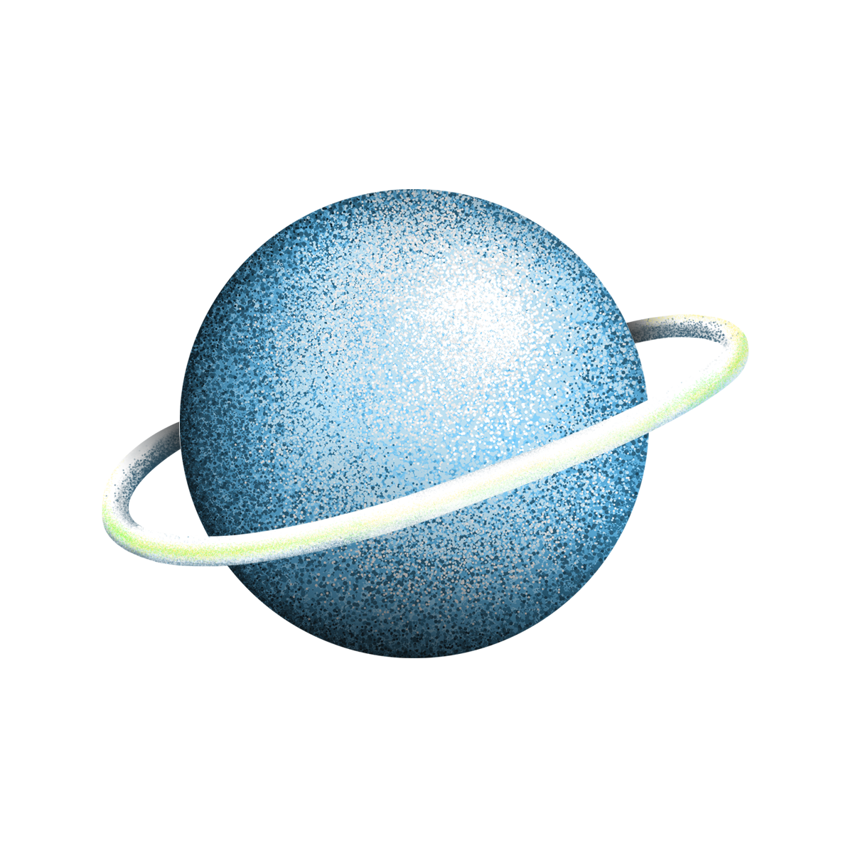
RESOURCES
ILLUSTRATION
Device mockup infographic
PHOTOS
Low angle man woman looking their tablet
Lawyer his client shaking hands together desk
Hand holding mobile device close up
Businessman holding high tech tablet
Crop woman browsing laptop bed
Happy young woman holding tablet
Handsome adult man holding laptop

Slide 39
Instructions for use (free users)
In order to use this template, you must credit Slidesgo by keeping the Thanks slide.
You are allowed to:
Modify this template.
Use it for both personal and commercial purposes.
You are not allowed to:
Sublicense, sell or rent any of Slidesgo Content (or a modified version of Slidesgo Content).
Distribute this Slidesgo Template (or a modified version of this Slidesgo Template) or include it in a database or in any other product or service that offers downloadable images, icons or presentations that may be subject to distribution or resale.
Use any of the elements that are part of this Slidesgo Template in an isolated and separated way from this Template.
Delete the “Thanks” or “Credits” slide.
Register any of the elements that are part of this template as a trademark or logo, or register it as a work in an intellectual property registry or similar.
For more information about editing slides, please read our FAQs or visit Slidesgo School:
https://slidesgo.com/faqs and https://slidesgo.com/slidesgo-school

Slide 40
Instructions for use (premium users)
In order to use this template, you must be a Premium user on Slidesgo.
You are allowed to:
Modify this template.
Use it for both personal and commercial purposes.
Hide or delete the “Thanks” slide and the mention to Slidesgo in the credits.
Share this template in an editable format with people who are not part of your team.
You are not allowed to:
Sublicense, sell or rent this Slidesgo Template (or a modified version of this Slidesgo Template).
Distribute this Slidesgo Template (or a modified version of this Slidesgo Template) or include it in a database or in any other product or service that offers downloadable images, icons or presentations that may be subject to distribution or resale.
Use any of the elements that are part of this Slidesgo Template in an isolated and separated way from this Template.
Register any of the elements that are part of this template as a trademark or logo, or register it as a work in an intellectual property registry or similar.
For more information about editing slides, please read our FAQs or visit Slidesgo School:
https://slidesgo.com/faqs and https://slidesgo.com/slidesgo-school

Slide 41
Fonts & colors used
This presentation has been made using the following fonts:
Oswald
(https://fonts.google.com/specimen/Oswald)
Nunito
(https://fonts.google.com/specimen/Nunito)
#1a1a1a
#ffffff
#ff87d7
#ff3abd

Slide 42



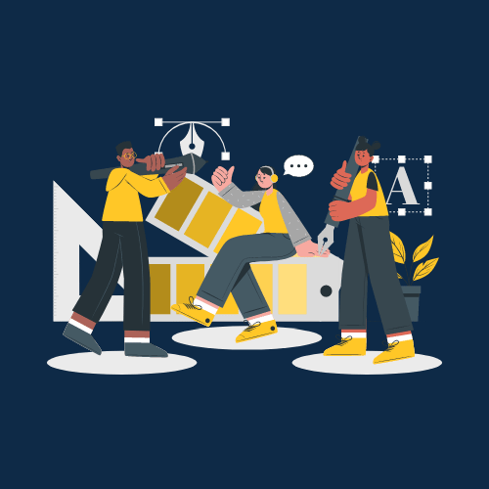

Stories by Freepik
Create your Story with our illustrated concepts. Choose the style you like the most, edit its colors, pick the background and layers you want to show and bring them to life with the animator panel! It will boost your presentation. Check out How it Works.
Pana
Amico
Bro
Rafiki
Cuate

Slide 43
Use our editable graphic resources...
You can easily resize these resources without losing quality. To change the color, just ungroup the resource and click on the object you want to change. Then, click on the paint bucket and select the color you want. Group the resource again when you’re done. You can also look for more infographics on Slidesgo.

Slide 46
JANUARY
FEBRUARY
MARCH
APRIL
MAY
JUNE
PHASE 1
Task 1
Task 2
PHASE 2
Task 1
Task 2
JANUARY
FEBRUARY
MARCH
APRIL
PHASE 1
Task 1
Task 2

Slide 49
...and our sets of editable icons
You can resize these icons without losing quality.
You can change the stroke and fill color; just select the icon and click on the paint bucket/pen.
In Google Slides, you can also use Flaticon’s extension, allowing you to customize and add even more icons.

Slide 50
Educational Icons
Medical Icons

Slide 51
Business Icons
Teamwork Icons

Slide 52
Help & Support Icons
Avatar Icons

Slide 53
Creative Process Icons
Performing Arts Icons

Slide 54
Nature Icons

Slide 55
SEO & Marketing Icons

Slide 56


